Slide 1
Physics for Scientists and Engineers
Paul A. Tipler • Gene Mosca
Fifth Edition
Chapter 39:
Relativity
Copyright © 2004 by W. H. Freeman & Company

Slide 2
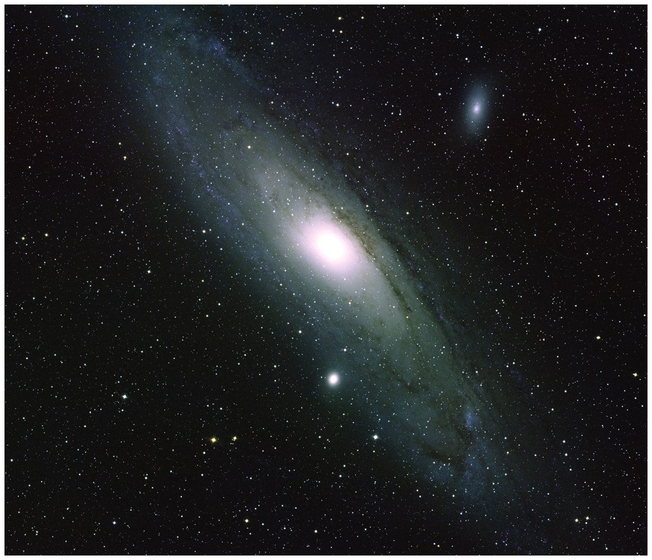

Slide 3
39-1
Newtonian Relativity

Slide 4
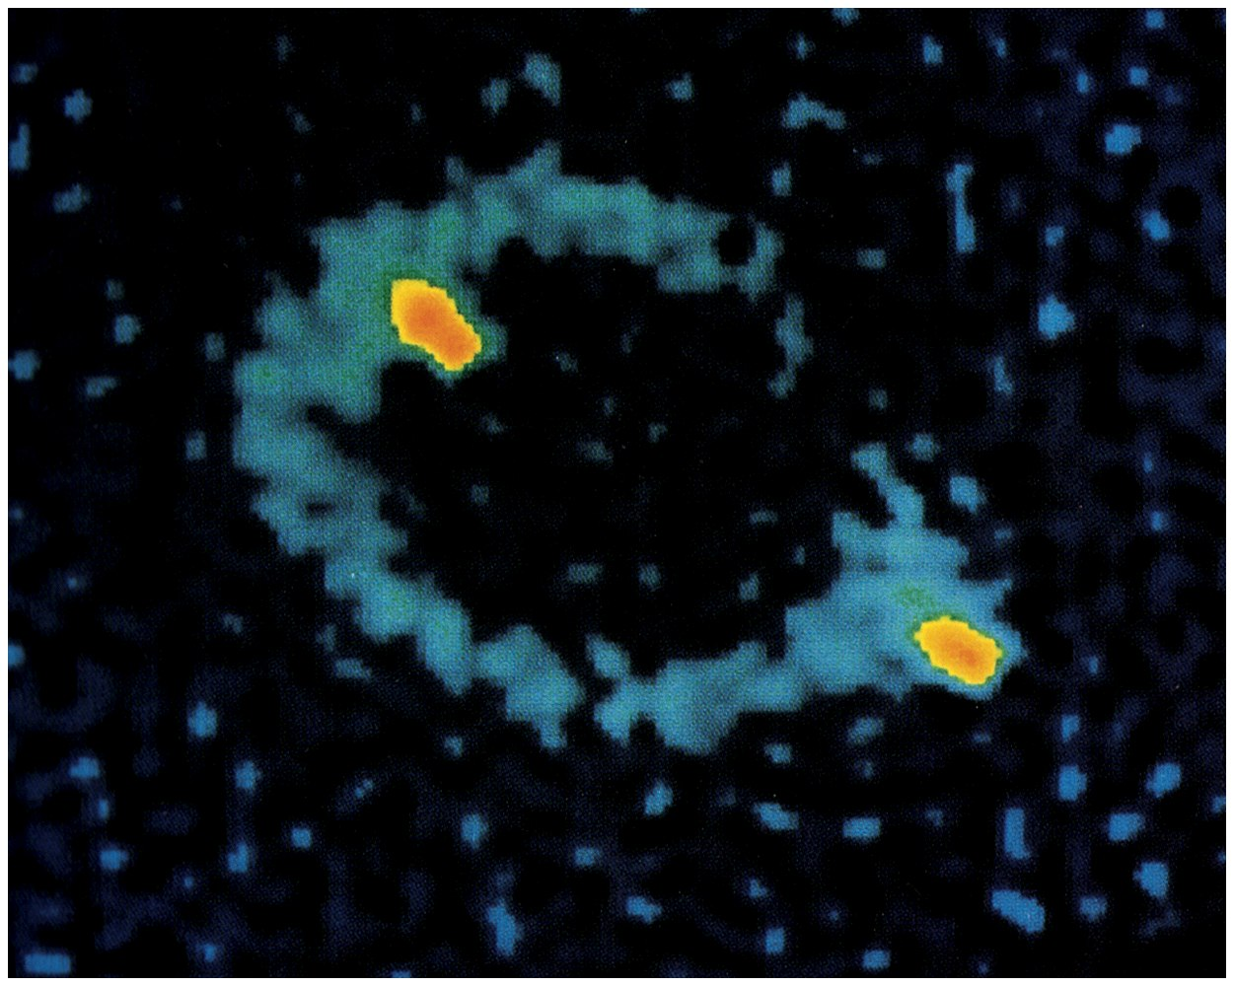

Slide 5


Slide 6
39-2
Einstein’s Postulates

Slide 7


Slide 8
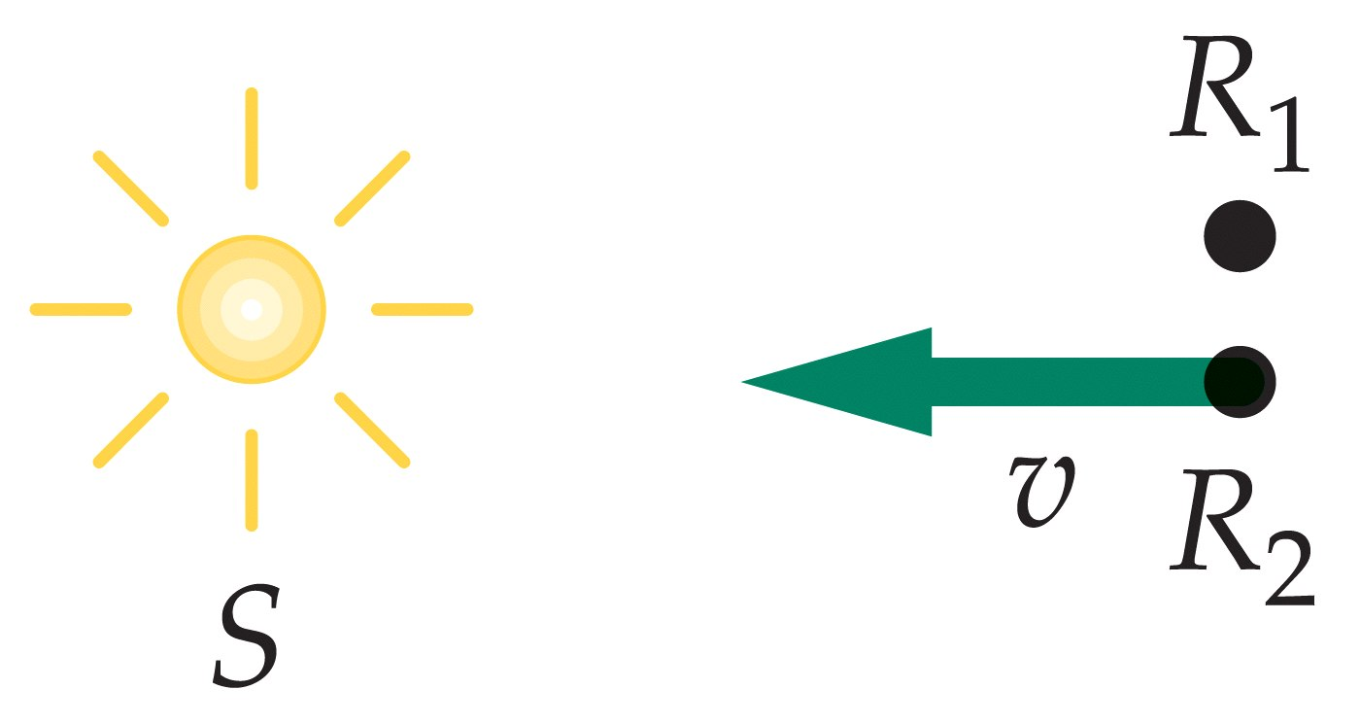

Slide 9
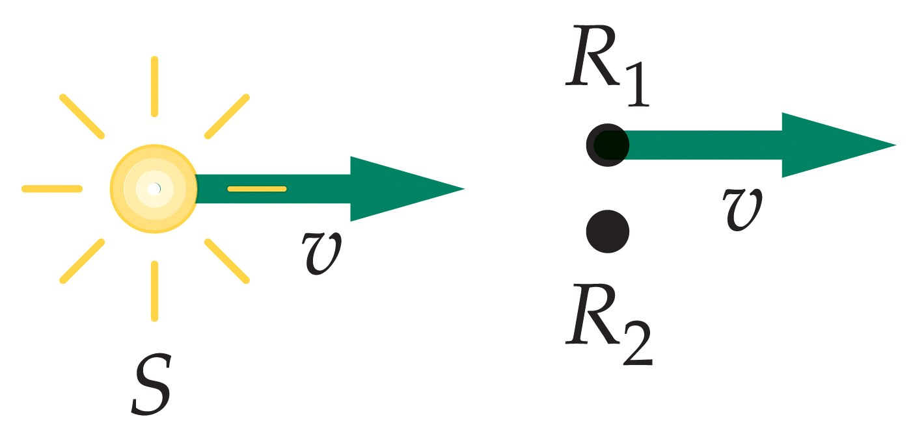

Slide 10


Slide 11
39-3
The Lorentz Transformation

Slide 12
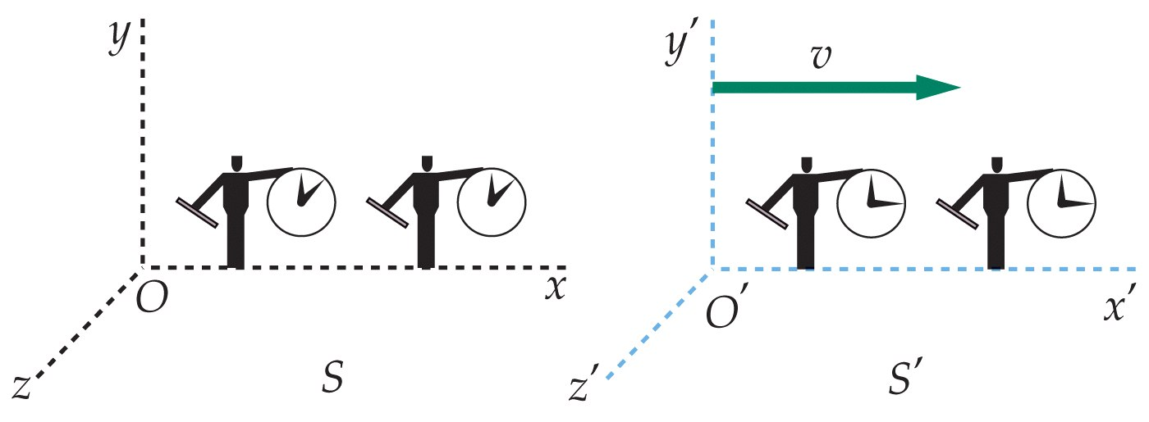

Slide 13


Slide 14
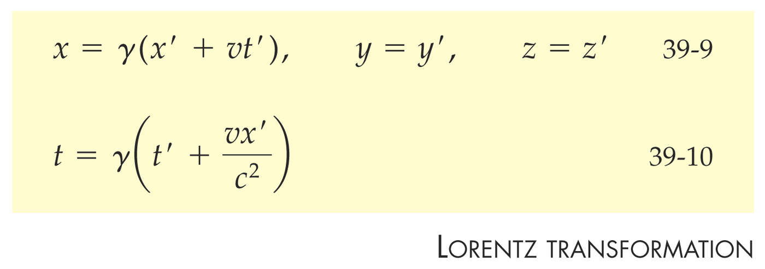

Slide 15


Slide 16
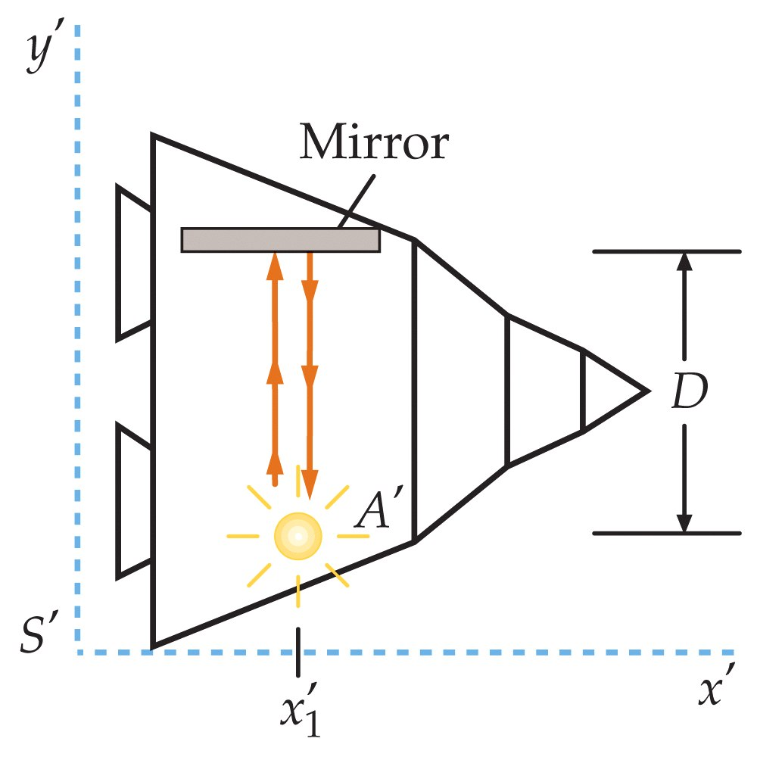

Slide 17
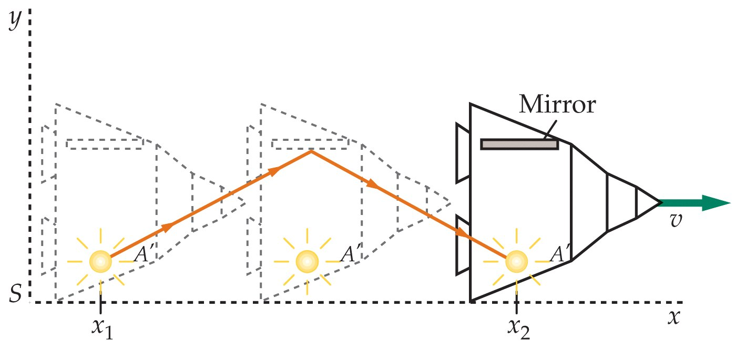

Slide 18
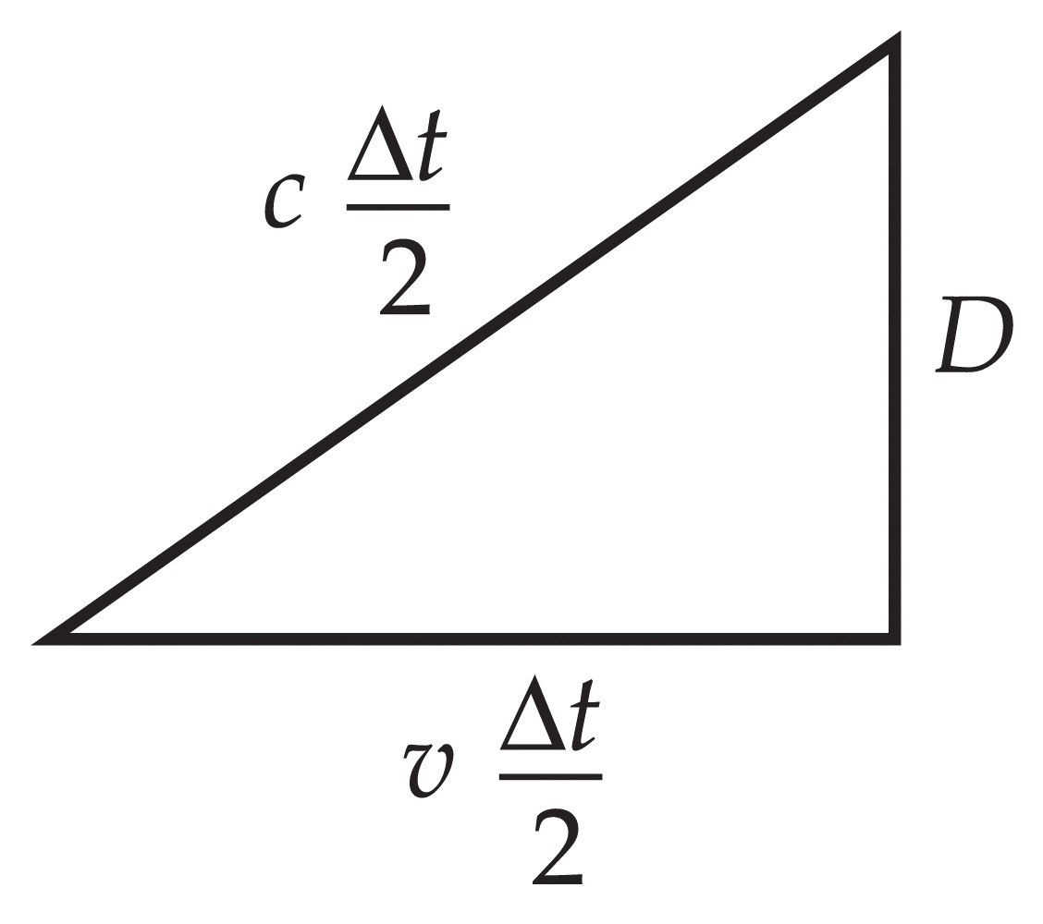

Slide 19
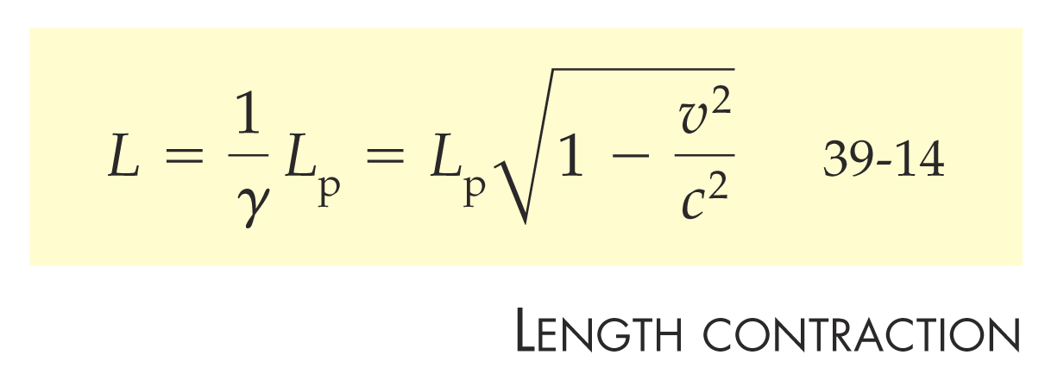

Slide 20
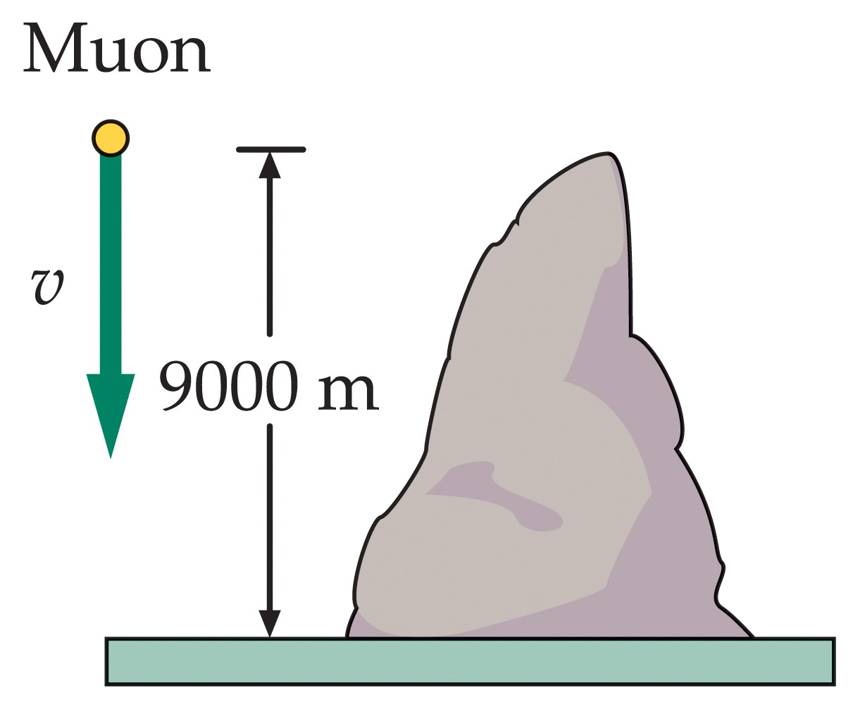

Slide 21
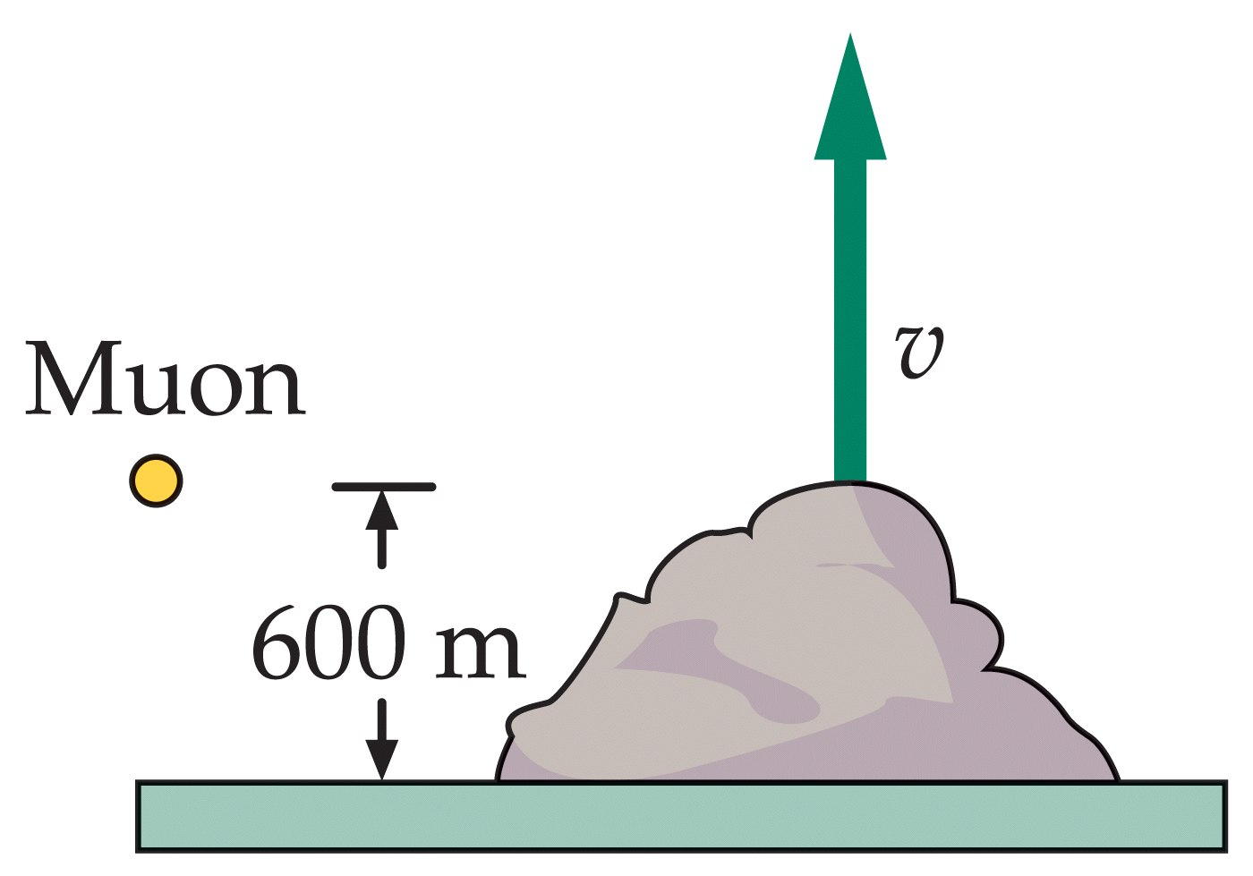

Slide 22
39-4
Clock Synchronization and Simultaneity

Slide 23


Slide 24


Slide 25


Slide 26
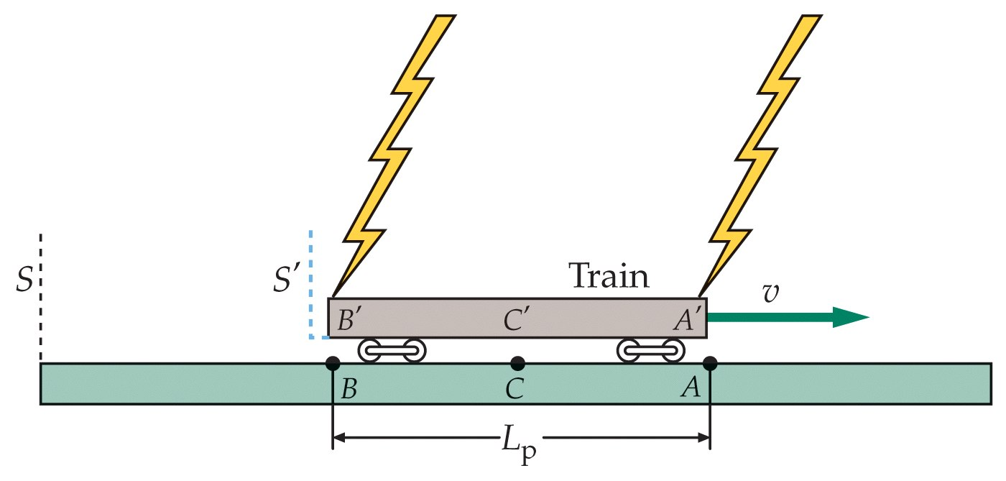

Slide 27
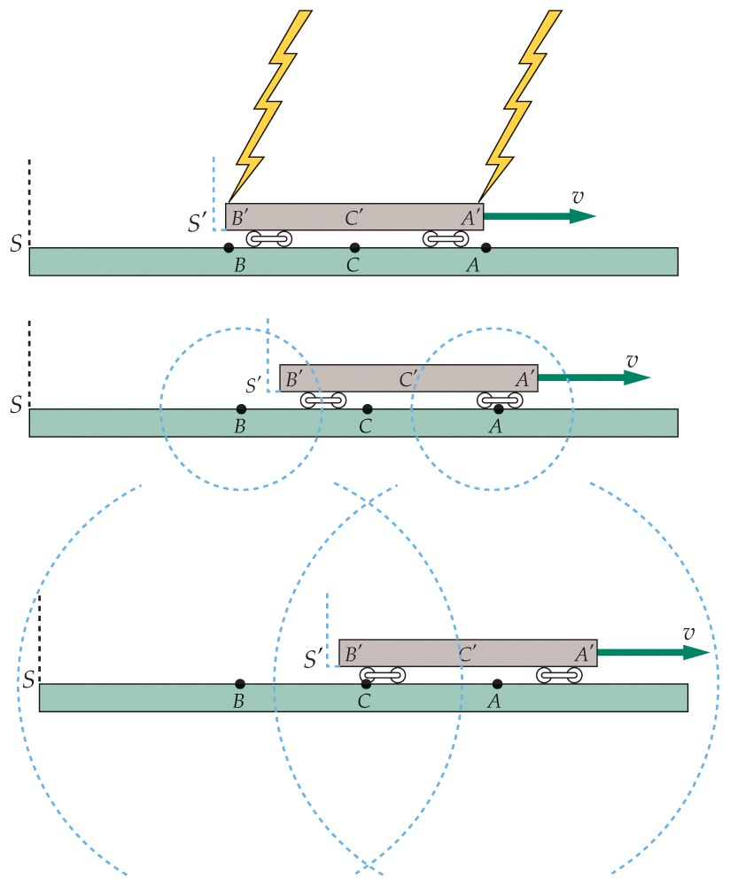

Slide 28
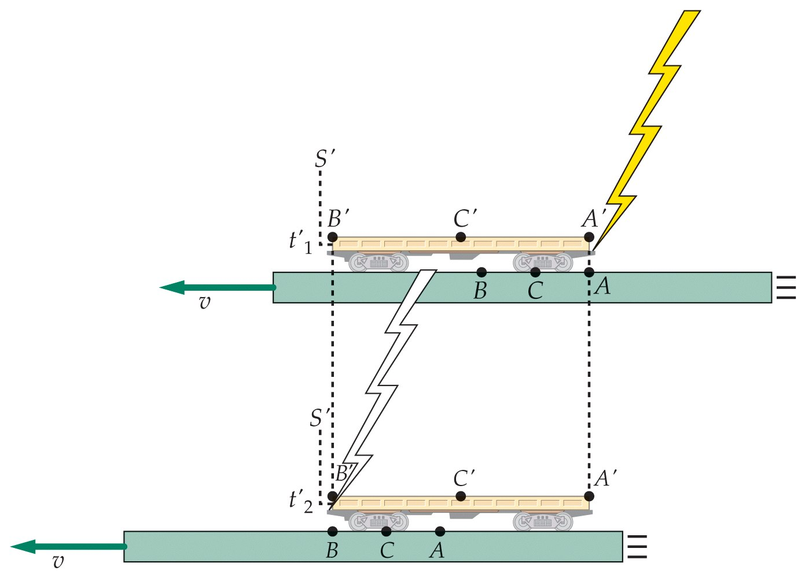

Slide 29
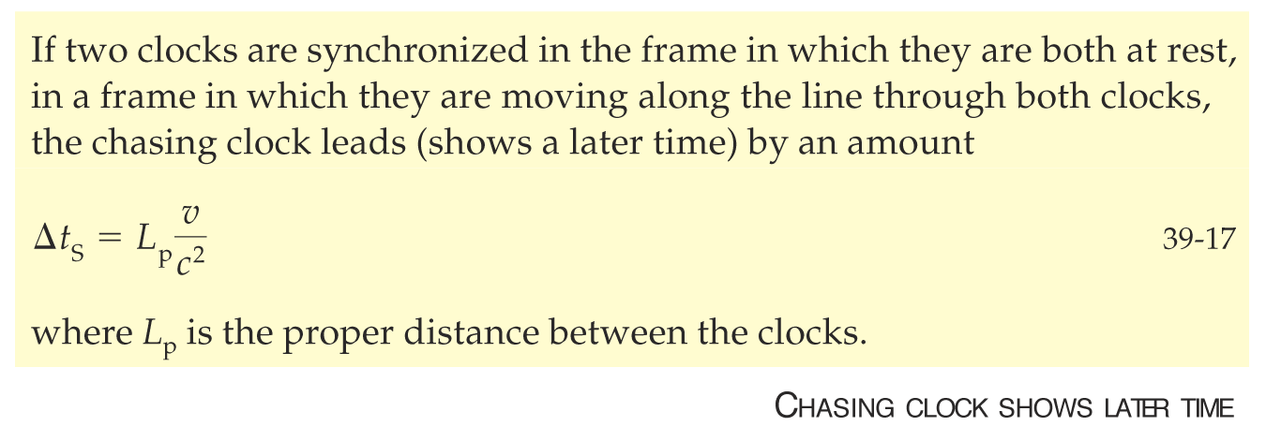

Slide 30
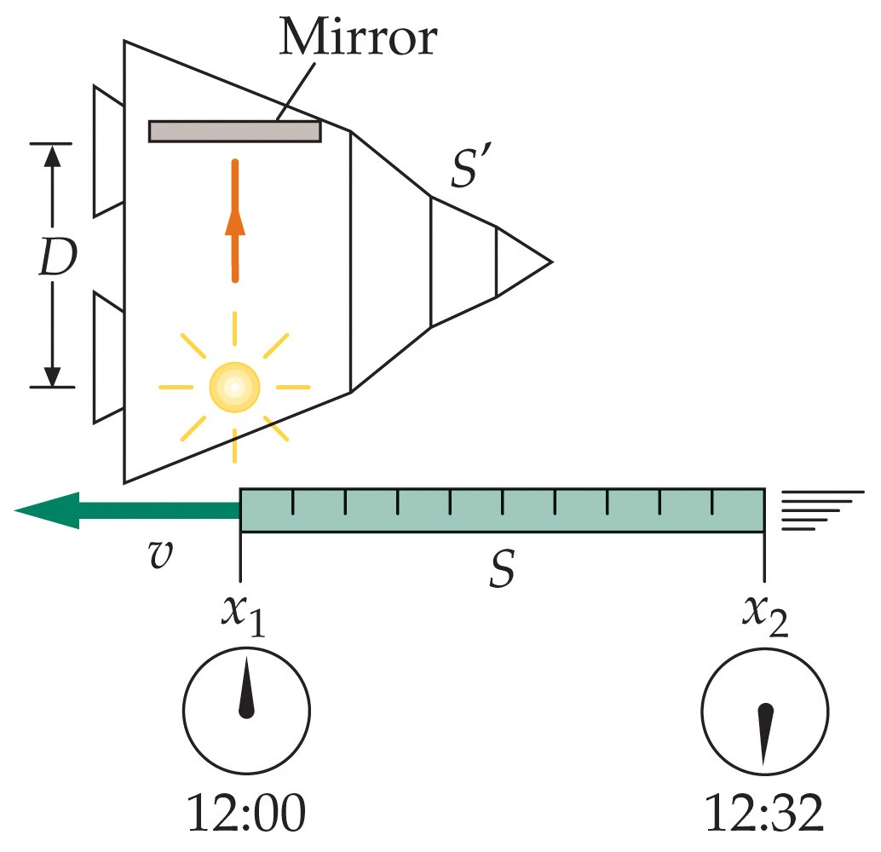

Slide 31
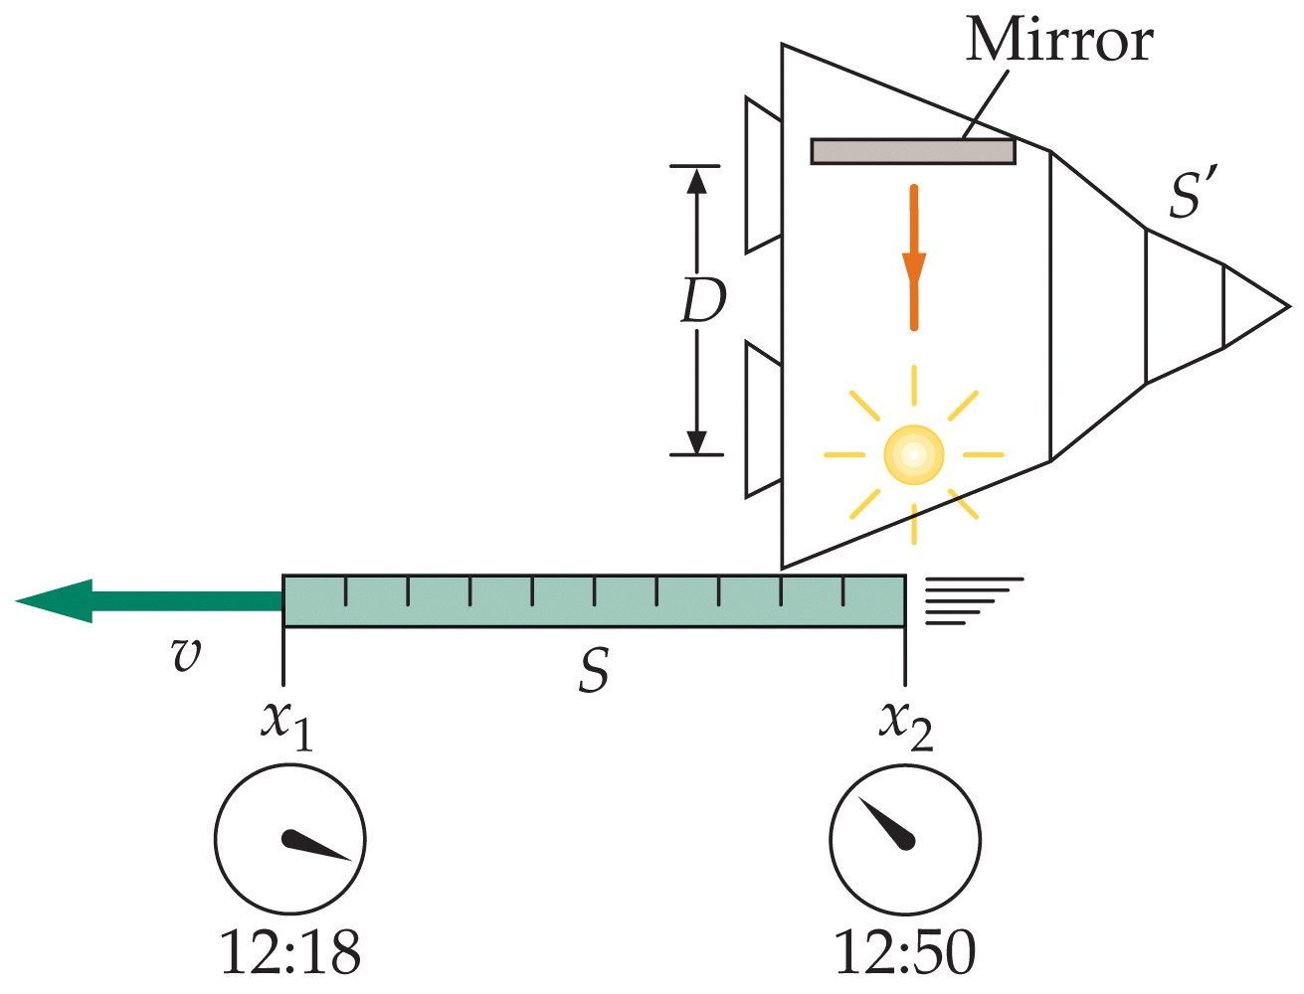

Slide 32
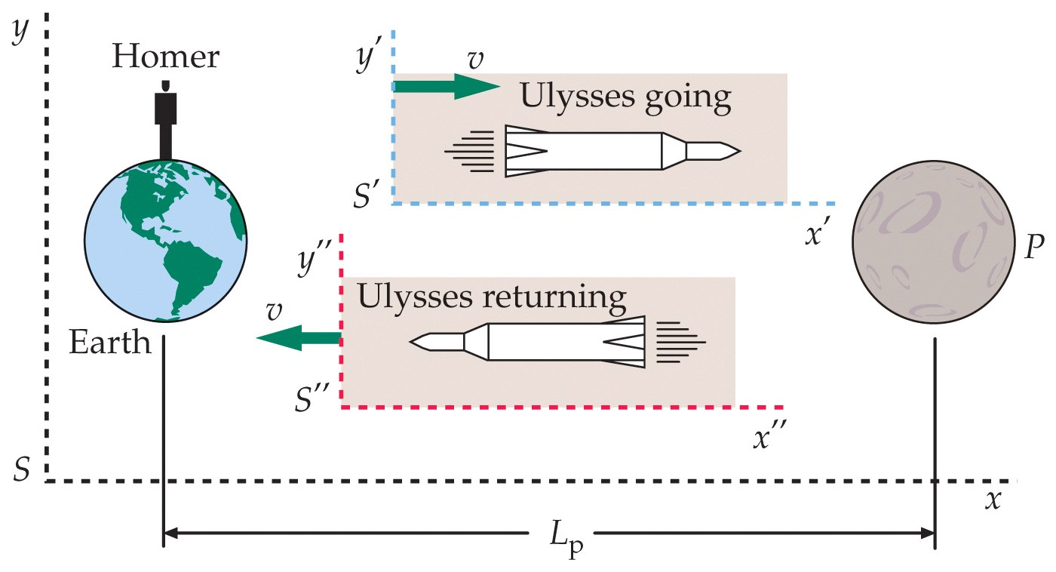

Slide 33
39-5
The Velocity Transformation

Slide 34
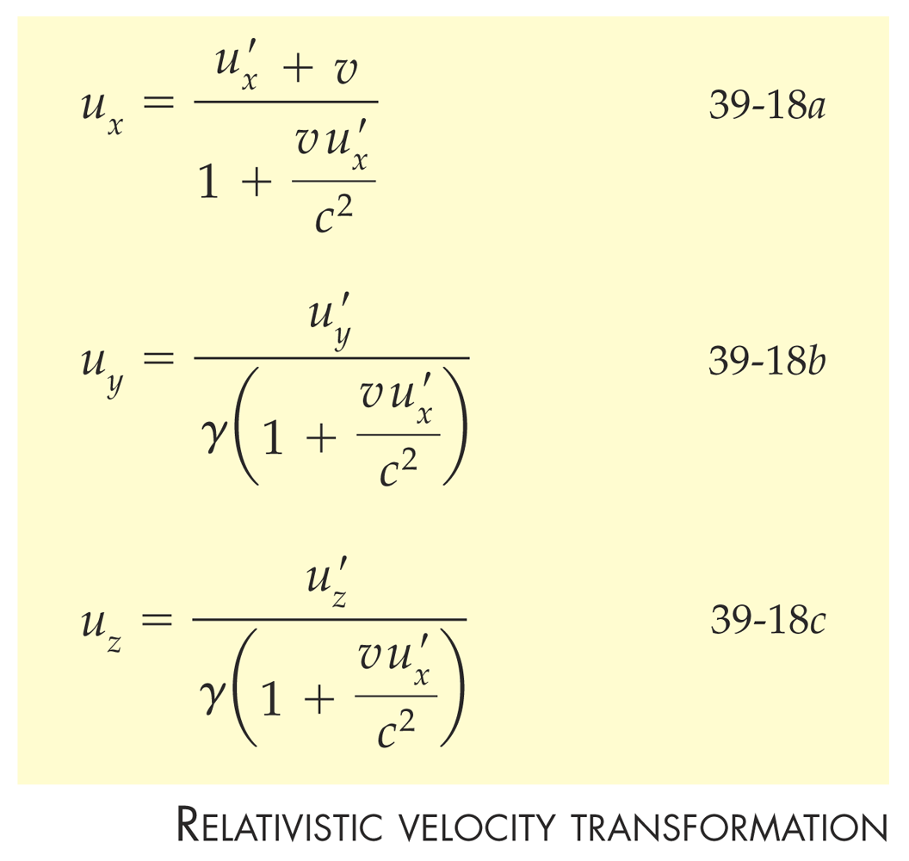

Slide 35
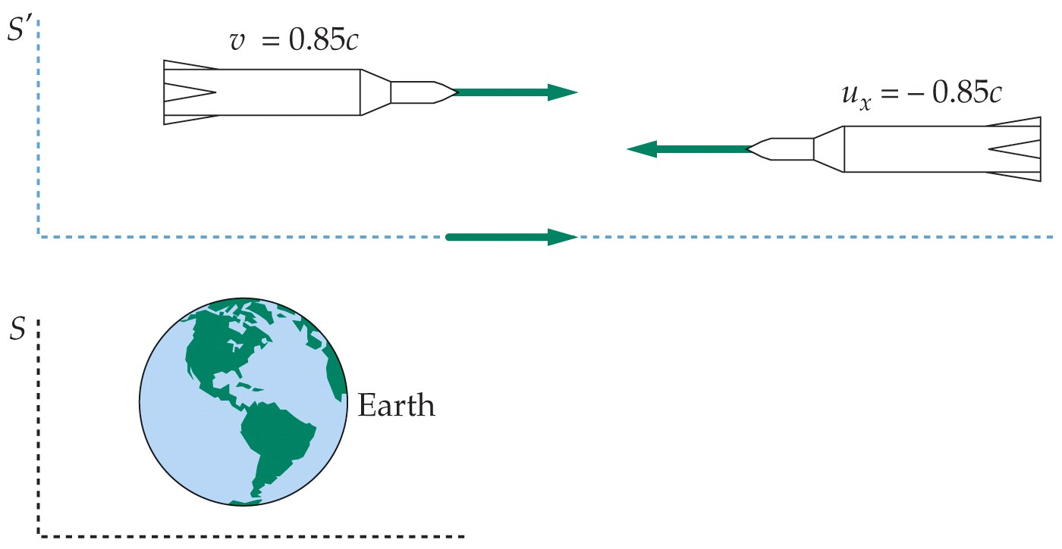

Slide 36
39-6
Relativistic Momentum

Slide 37
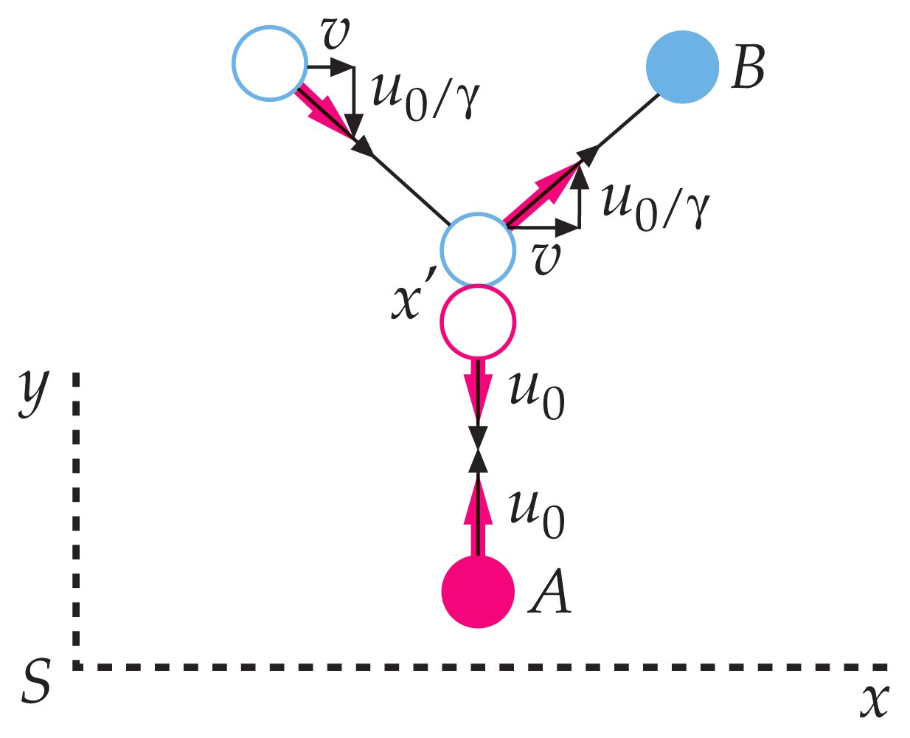

Slide 38
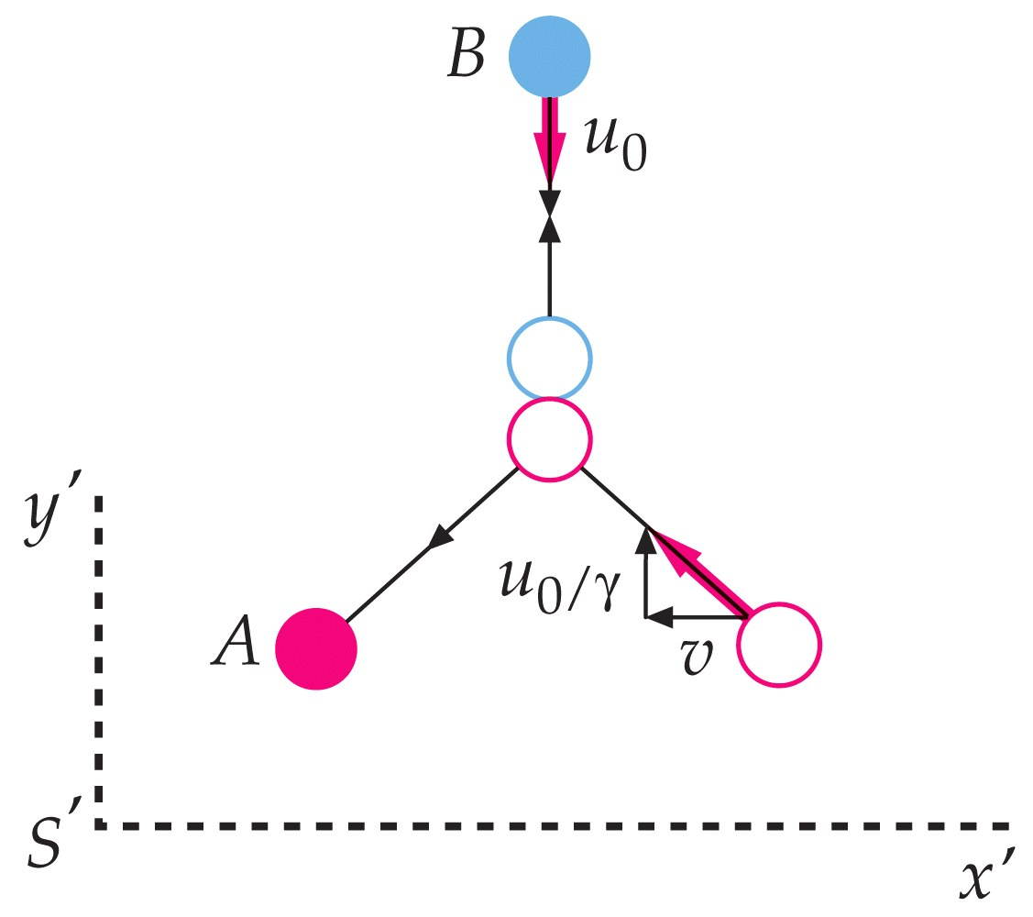

Slide 39
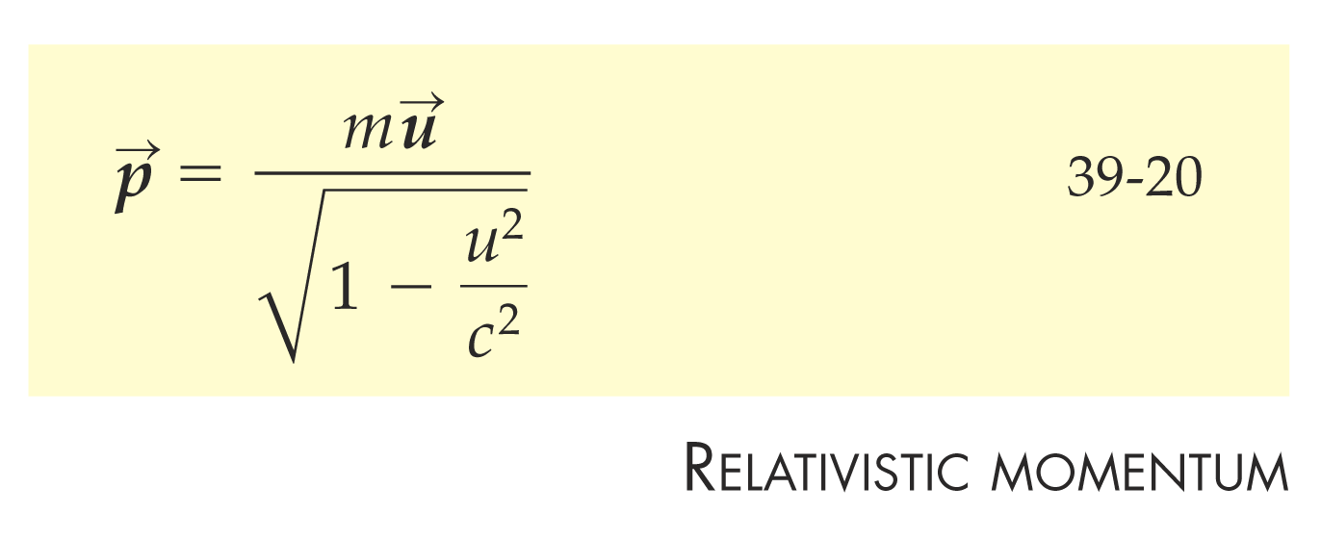

Slide 40
39-7
Relativistic Energy

Slide 41
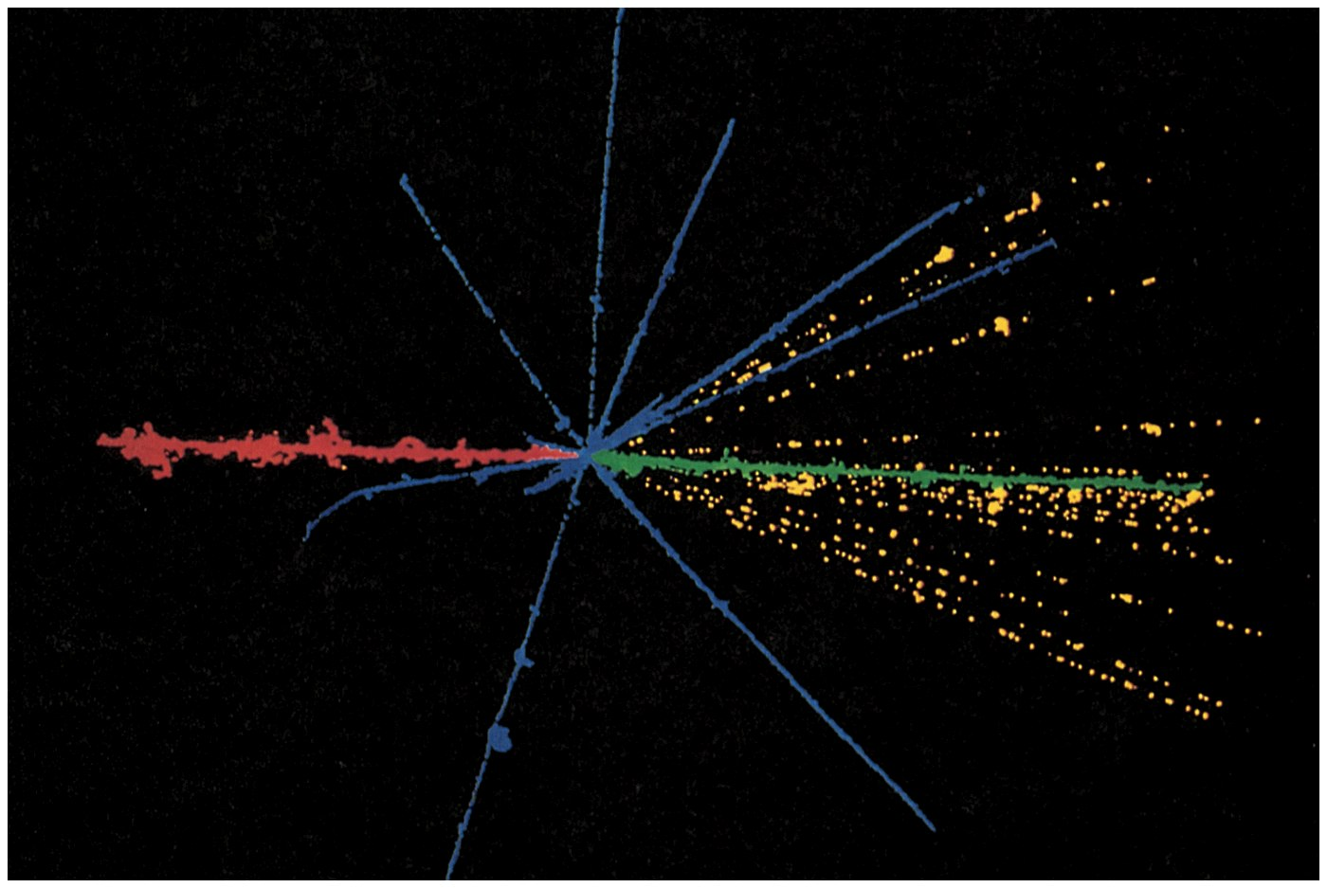

Slide 42
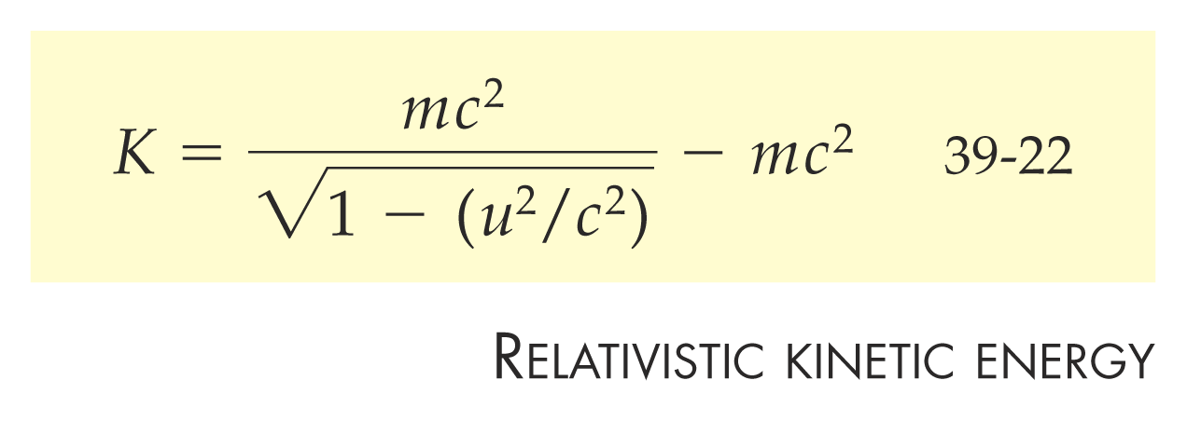

Slide 43


Slide 44


Slide 45
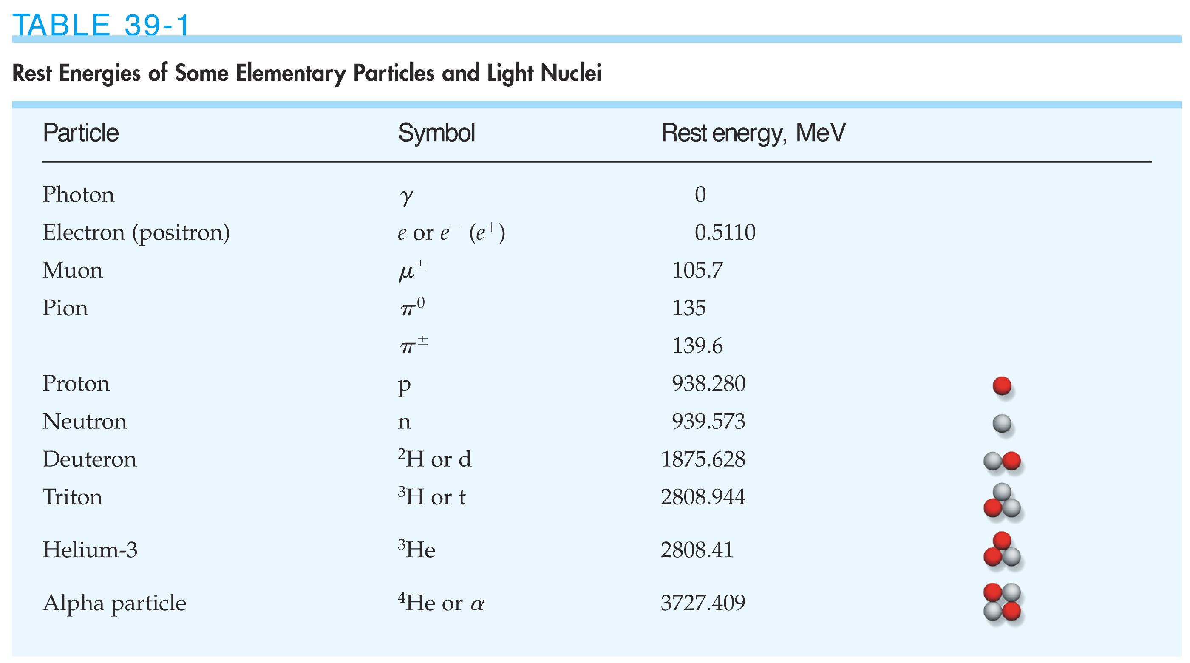

Slide 46


Slide 47
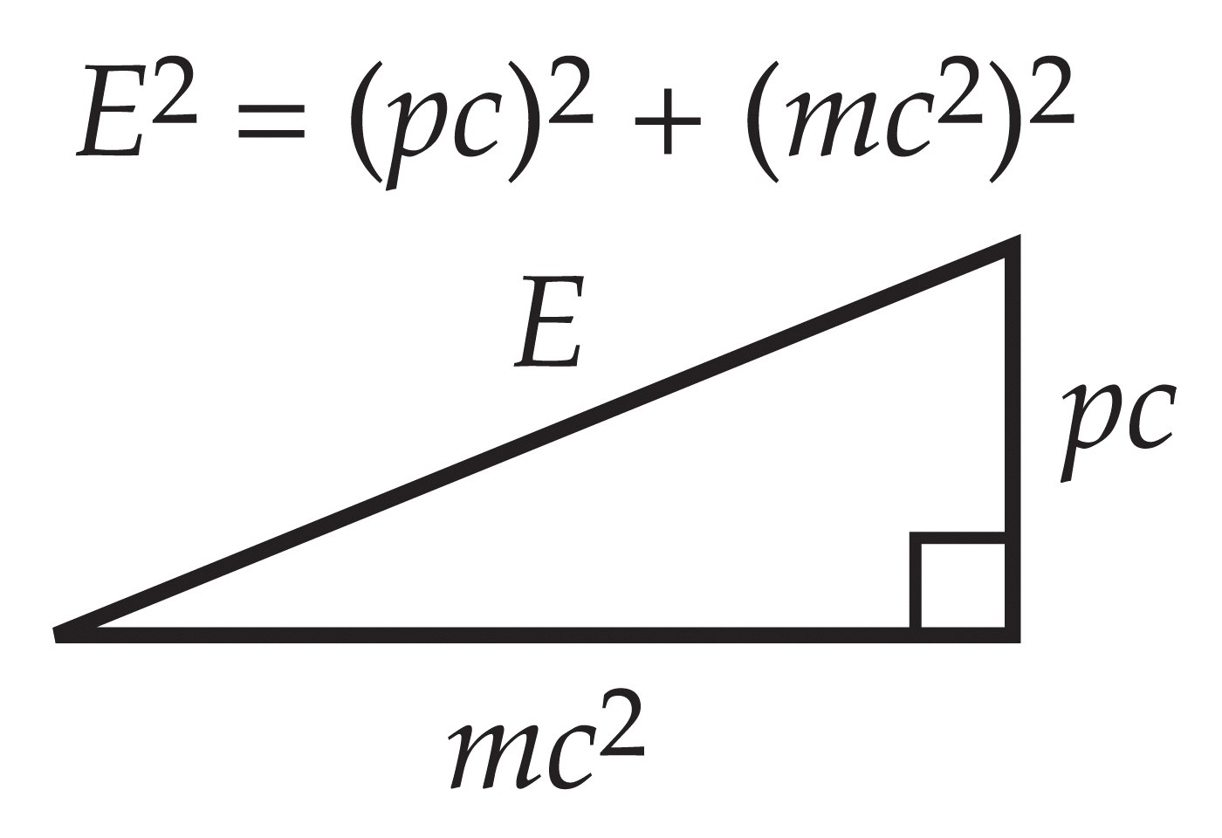

Slide 48
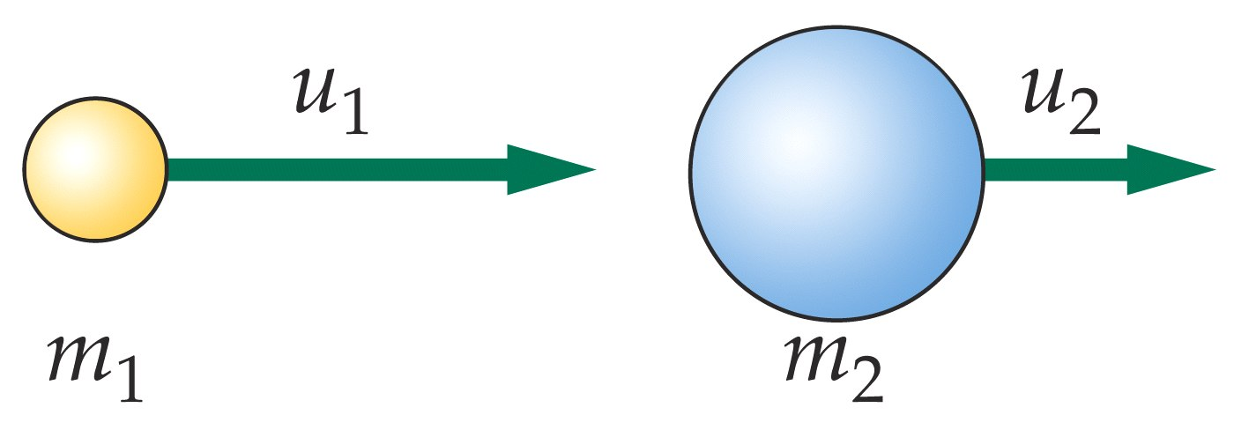

Slide 49
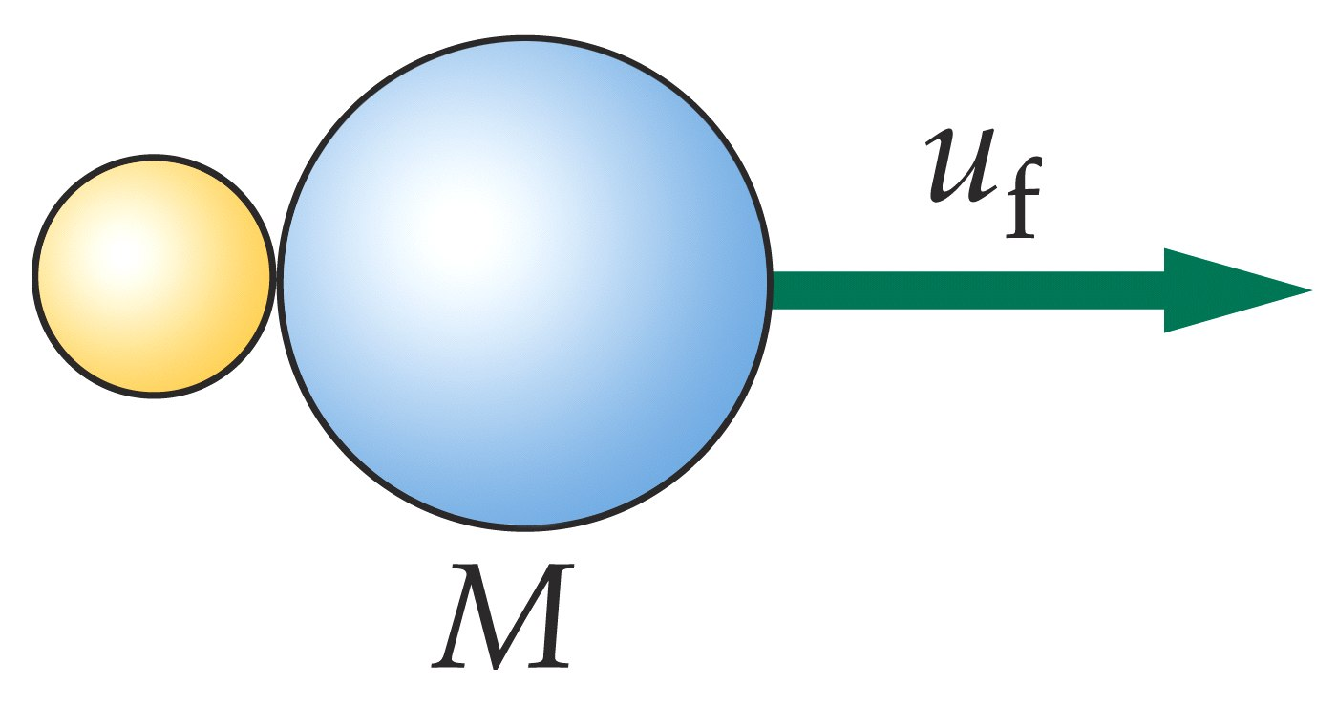

Slide 50
39-8
General Relativity

Slide 51


Slide 52
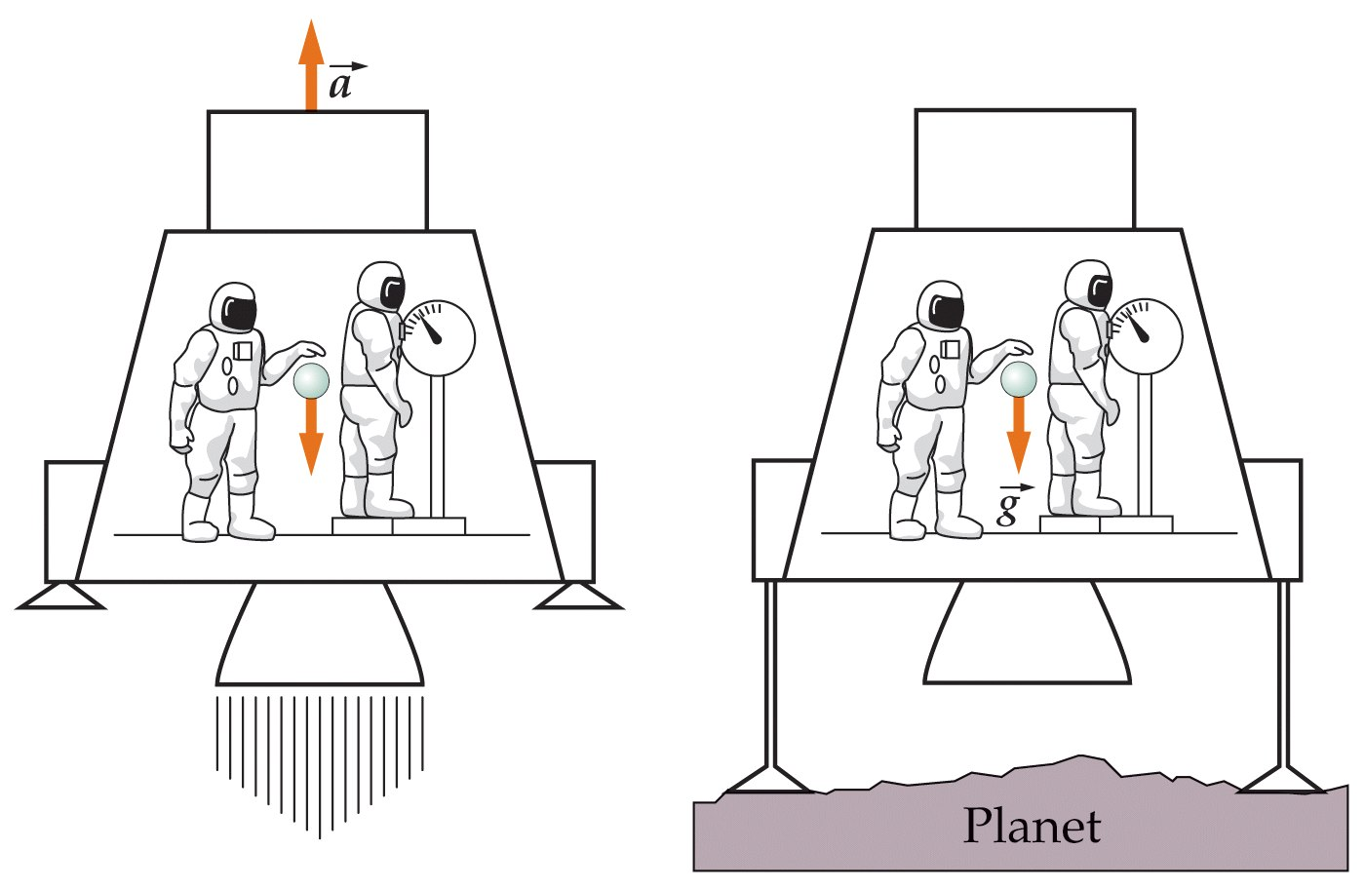

Slide 53
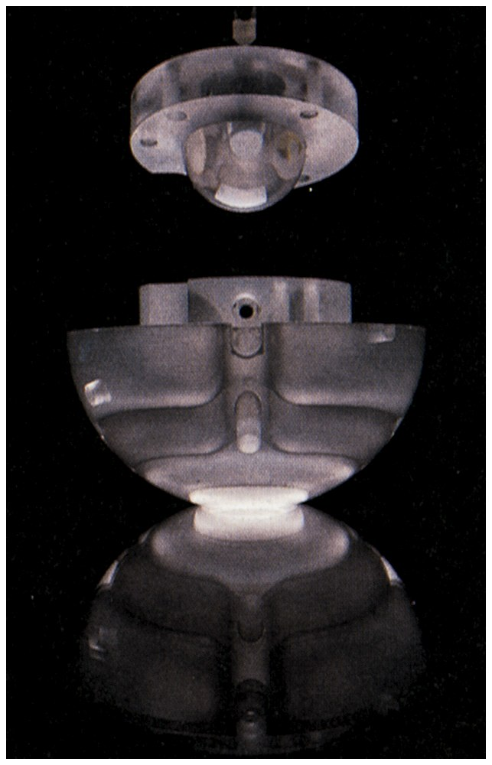

Slide 54
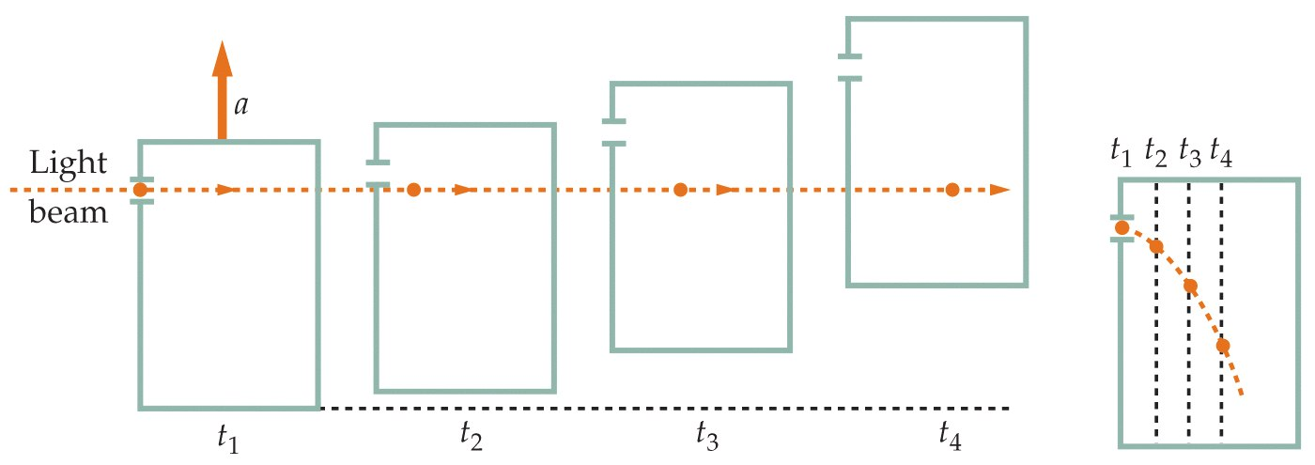

Slide 55
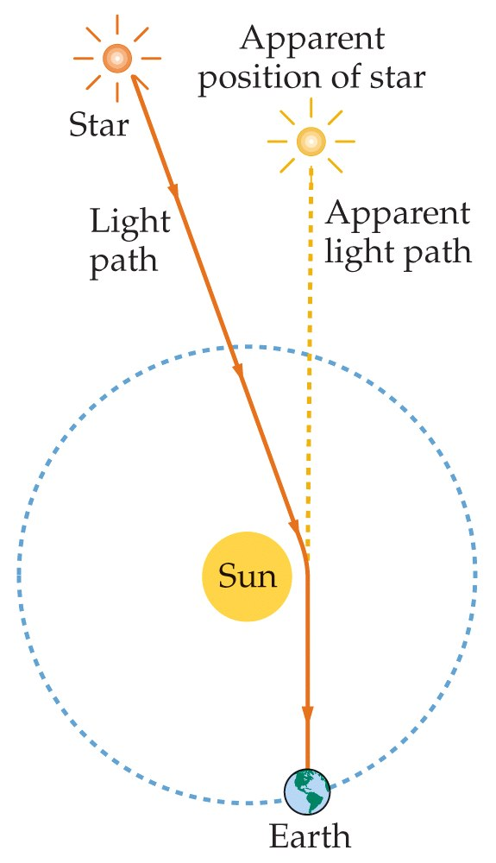

Slide 56
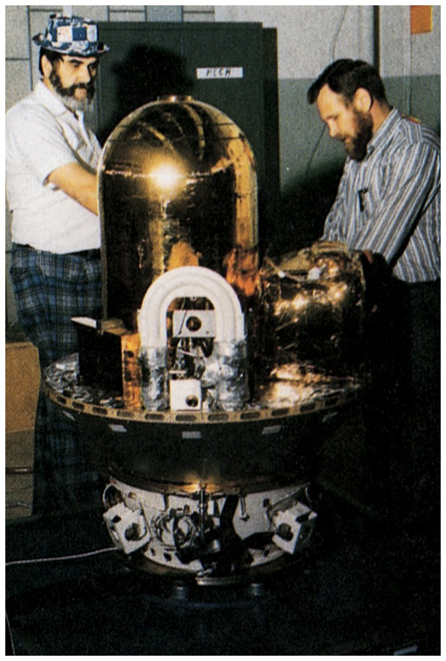

Slide 57
Problems

Slide 58
